Slide 1
Online Job Portal
Presented By
Miss. Pranali Gawade
Miss. Samina Sayyad
Miss. Neha Khedkar

Slide 2
Introduction
This project is aimed at developing an online search Portal for the Placement Details for job seekers.
The system is an online application that can be accessed throughout the organization and outside as well with proper login provided.
This system can be used as an Online Job Portal for job seekers. Job Seekers logging should be able to upload their information in the form of a CV.
Visitors/Company representatives logging in may also access/search any information put up by Job aspirants.

Slide 3
Existing System
Existing system are a failing in providing quick operation
Cost is high as well.
Processing very lengthy and time consuming.
More time consume for before generation.

Slide 4
Need Of Project
This system can be used as an Online Job Portal for the Placements providing to the an employees who are seeking for a job placement.
Job Seeker logging into the system and he can should be able to upload their information in the form of a CV. Visitors/Company representatives logging in may also access/search any information put up by JobSeeker.

Slide 5
Modules Of the Project
The modules involved are:
Admin
• Job Seeker
• Job Provider
• Notification
• Search
• Report
• Authentication

Slide 6
System Requirement
Hardware requirements:
For the Server:
Processor : Core 2 duo. And onwards
RAM : 512 MB(recommended)
Hard Disk : 40 GB (or more)
For the Client:
Processor : Core to duo.
RAM : 512 MB
Hard Disk : 40 GB (or more)

Slide 7
System Requirement Cont..
For the Server:
Operating System : Windows 7
Front End : HTML, JavaScript,CSS, PHP
Back End : MySql
Server : Xampp 7.0.8
For the Client:
Operating System : Windows 7.
Browsers : Firefox or Google chrome.

Slide 8
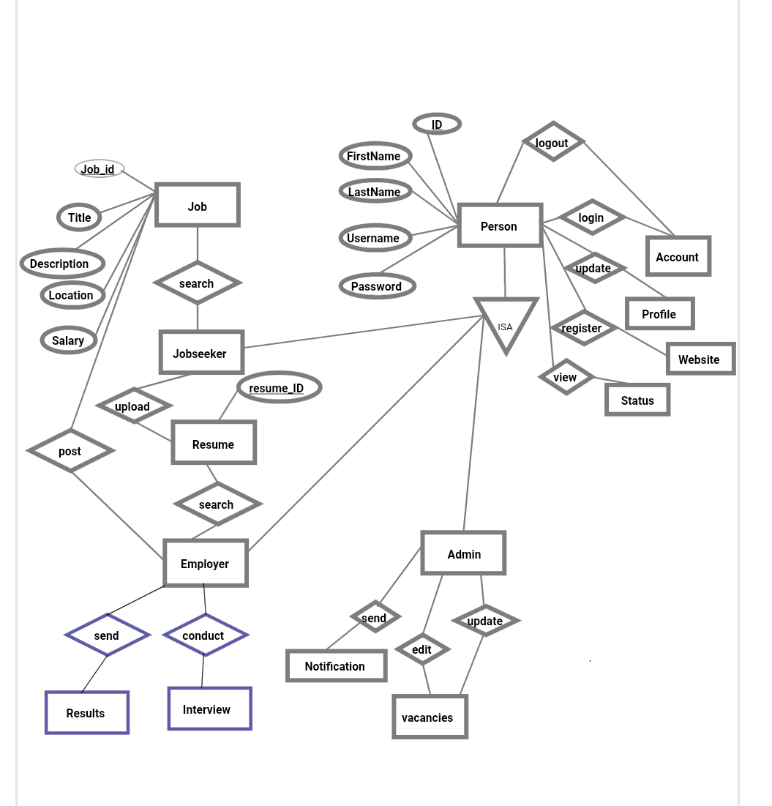
E-R Diagram

Slide 9







Sequence Diagram for Admin Login
  Admin
  Login
  Bal : AdminLogin
  Dal : DBHelper
  DataBase
1 : Login()
2 : CheckUser()
3 : Execute NonQuery()
4 : Exeute NonQuery()
5 : Response to ExecuteNonQuery()
  6 : Get Response()
7 : Show Result()

Slide 10
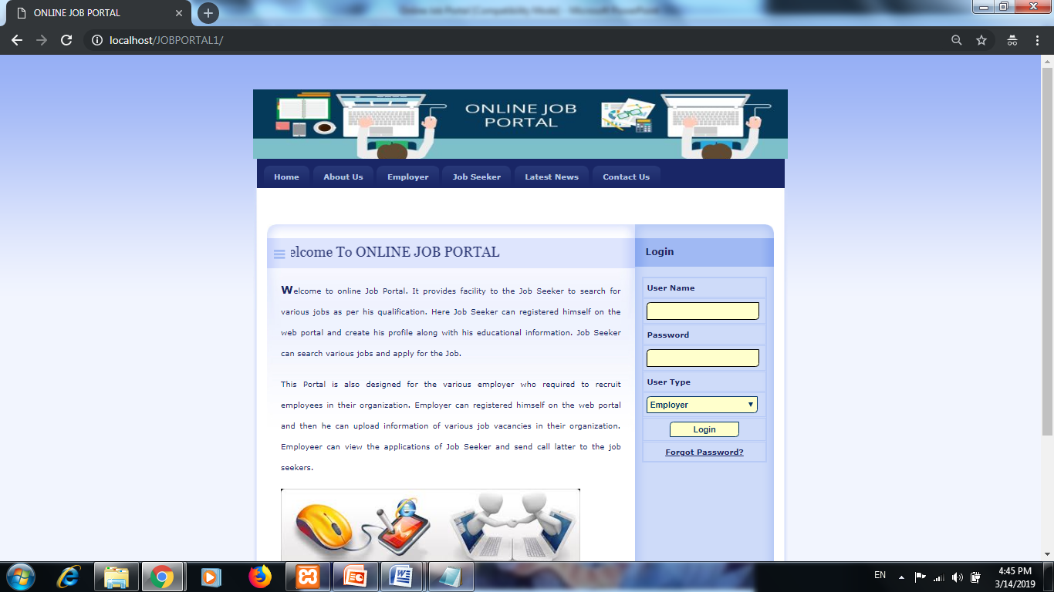
Screen Shot-Home

Slide 11
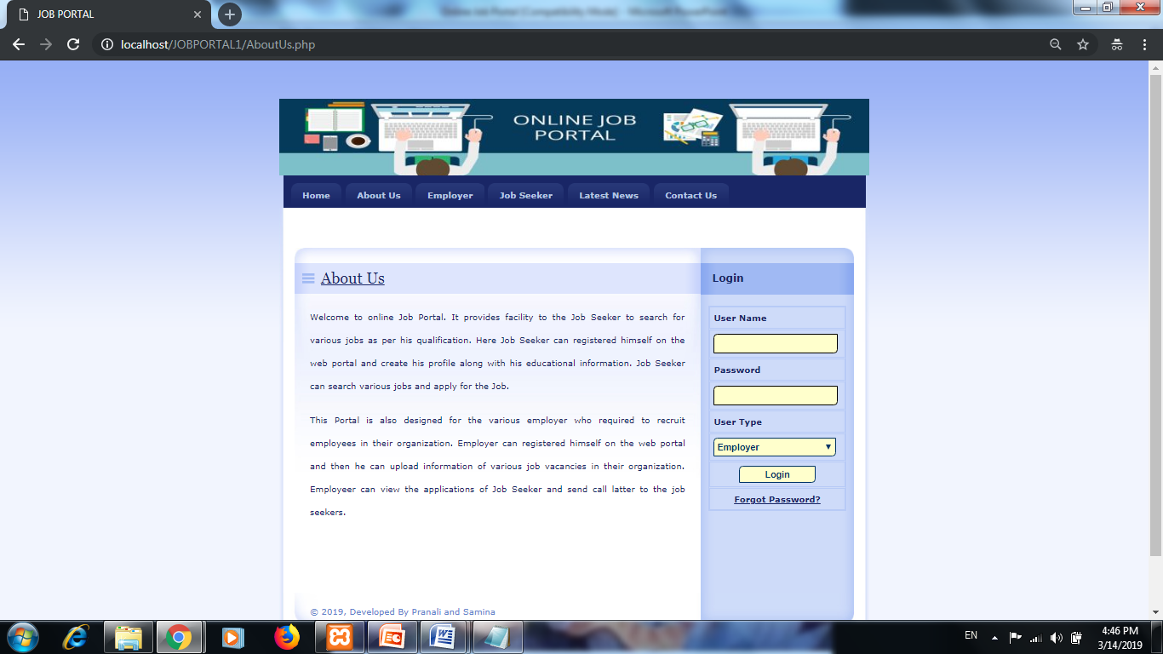
About Us

Slide 12
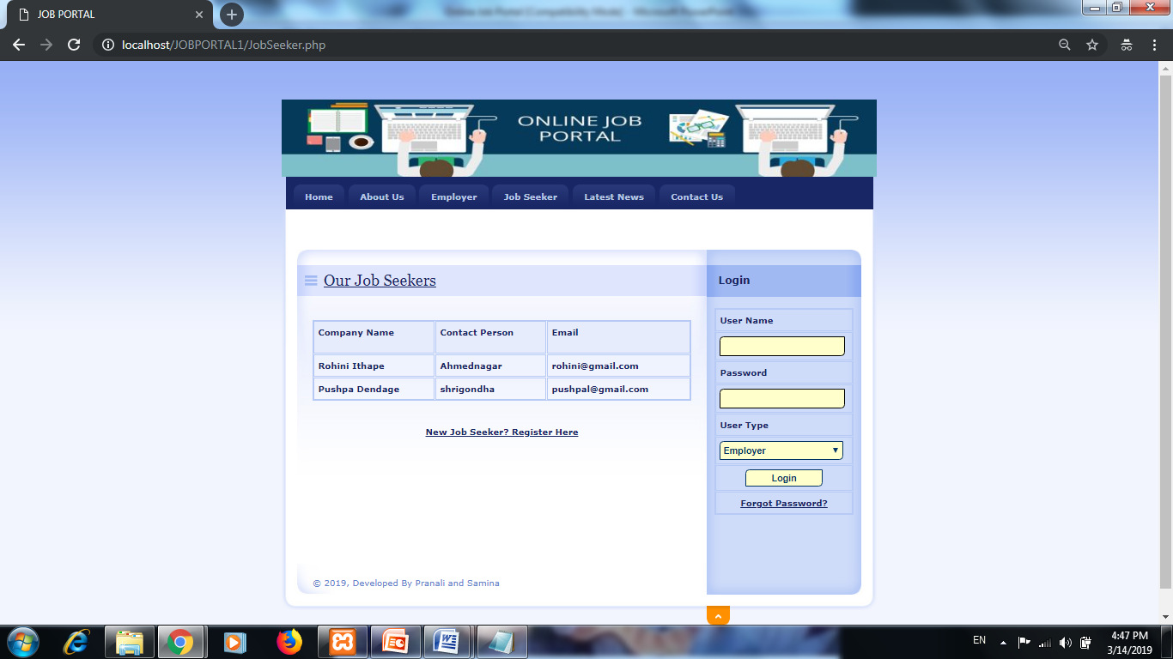
Job Seeker

Slide 13
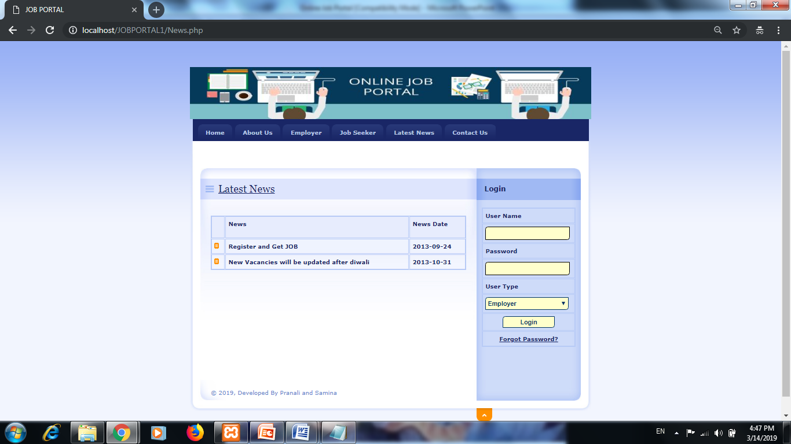
News

Slide 14
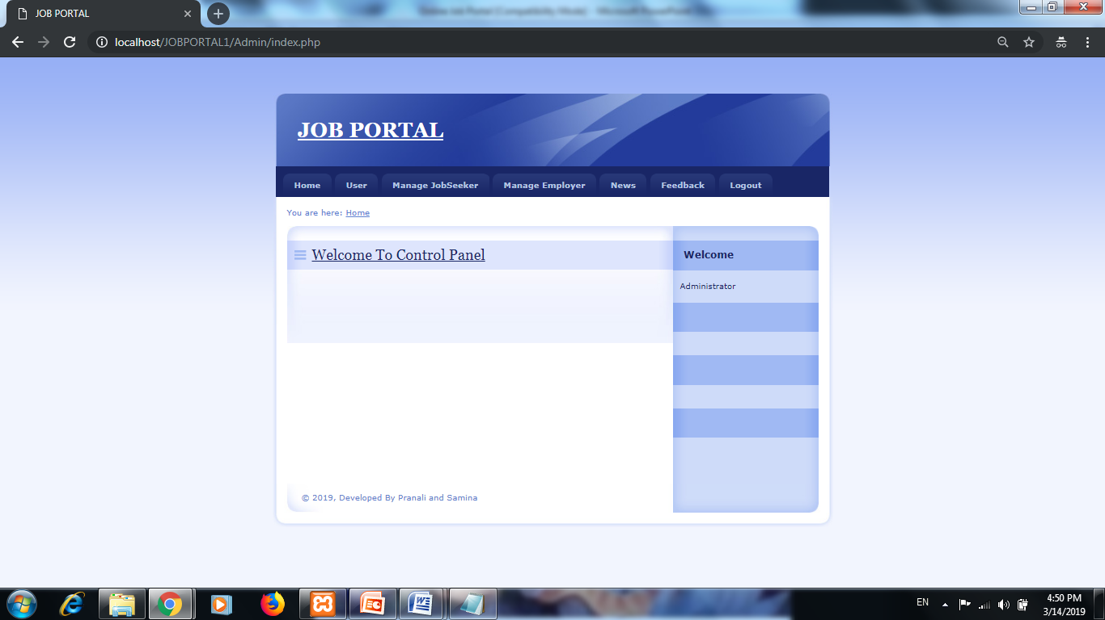
Admin Home

Slide 15
Future Scope
  This System being web-based and an undertaking of Cyber Security Division, needs to be thoroughly tested to find out any security gaps.
  A console for the data centre may be made available to allow the personnel to monitor on the sites which were cleared for hosting during a particular period.
  Moreover, it is just a beginning; further the system may be utilized in various other types of auditing operation viz. Network auditing or similar process/workflow based applications...

Slide 16
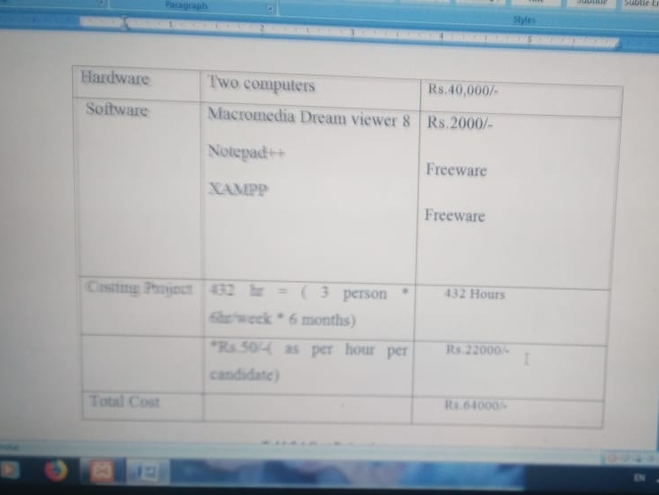
COST ESTIMATION

Slide 17
Bibliography
  www.timejob.com
  www.firstnaukary.com
  www.w3schools.com

Slide 18
Thank You

